Slide 1

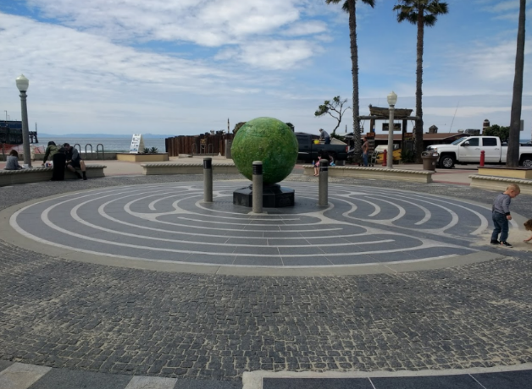
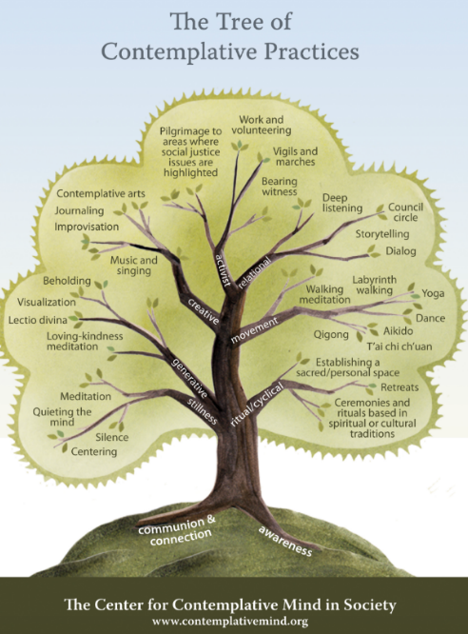
Perceived Benefits of Labyrinth Types as Advocated by Public Health Professionals
Phoebe Cheney, Zeqin He, Kaylee Marihugh, Hannah Scally, Katlyn Whitaker, and Valerie A. Ubbes, PhD, MCHES
Public Health Majors from the Department of Kinesiology and Health
Methods
1. A draft of the survey instrument was reviewed by the research team then edited to reduce survey length and question redundancy.
2. Institutional Review Board approval was sought.
3. Final survey instrument was written, reviewed, and edited multiple times in Qualtrics.
4. Research team field tested The Labyrinth Survey in the Qualtrics platform among themselves.
5. After trouble shooting was completed, the approved evaluation project #02825e commenced to do "An Evaluation Study of the Labyrinth Survey as an Online Assessment Tool".
6. In order to determine the effects and benefits of labyrinth types, an online finger labyrinth was completed by undergraduate public health students. After completing the labyrinth, a non-randomized, online survey was completed by those students.
Results
The results of the survey demonstrate the effectiveness of utilizing a labyrinth in regards to health and wellness. In particular, 68.42% of participants (n=19) reported labyrinth walking would serve as exercise for the body and mind, 66.67% reported labyrinth walking would assist to clear the mind, 63.63% reported labyrinth walking would serve as a therapeutic movement, 52.63% reported labyrinth walking would improve overall health and wellbeing, and 54.54% reported utilization of a labyrinth would serve as a coping mechanism, each aligning with the earlier proposed benefits of labyrinths types.
What is a labyrinth?
A labyrinth is a circuitous pathway with one entrance for walking to the center and back out again. Labyrinths are used as “an ancient tool for contemplation and inner cultivation” (Scaper & Camp, 2013). Labyrinth walking can be used for a variety of physical and mental health benefits, including stress management, lowering blood pressure, and increasing self-efficacy.
What are the Benefits of Labyrinth Walking?
Professional Identity and Career Development: Labyrinths have been used to promote identity development, including faculty training, human resources programming,multicultural programming, and higher education transitioning processes (Bigard, 2009).
Stress Reduction and Relaxation: “Results showed lower systolic blood pressures and pulse rates in labyrinth walkers compared to control subjects. In addition the labyrinth walkers reported higher satisfaction and relaxation than control subjects, by self-report questionnaire,” (Zucker, et al., 2016).
Counseling Mechanism: Labyrinths are being introduced into mental health services on college campuses as a counseling tool, which suggests that health care professionals can use labyrinths for clients in a non-clinical setting (Bigard, 2009).
Research Question:
How does labyrinth walking benefit professionals preparing for careers in public health and health care?
Goal of Project:
To administer a survey to Public Health Professionals after the use of a finger labyrinth to determine the perceived benefits of using a labyrinth.
Other Benefits of Labyrinth Walking?
Research by Fairbloom (2003) showed that taking time to walk a labyrinth taught healthcare workers to take better care of themselves and to use coping mechanisms in the midst of their hectic, demanding jobs.Taking the time to walk “enhances balance and self-efficacy” in individuals with chronic stroke (Salbach et al.,2005). Research consistently shows that exercise improves brain health, which may relate to walking labyrinths because people who choose to use labyrinths are engaging in the physical act of walking (Cotman, 2007).
Future Research
Because this pilot study was completed with a finger labyrinth, future research should include labyrinth walking as an intervention - and compare the differences in these labyrinth types. Additionally, further studies should reach a wider demographic to study the benefits of labyrinths on public health professionals of different ages, gender, and race ethnicities with different stress levels and self efficacy beliefs.
Notes:
Students: I have carefully edited the excellent content that you have provided and organized headings a bit more. Please make a handout for all the references using APA style and email that to me for proofing no later than Sunday night. Maybe Kaylee and Kaitlyn can do that reference list? The rest of you will conduct the study tomorrow by email and then reduce the data. I would like to see the Methods and Results by Sunday as well. The printer needs to be submitted for printing by Monday at 8 am. Good luck tomorrow. If you don’t like the green background, that is fine. You can change it. If you have additional content for benefits, there is room for one more sentence and source at the bottom of the second column. Optimism information? We need a reference for brain health and exercise. Thank you.

