Slide 1
Valerie A. Ubbes, PhD, CHES
Miami University, Oxford, OH
International Conference on Books, Publishing, & Libraries
College, Boston, MA
November 8, 2014

Slide 9
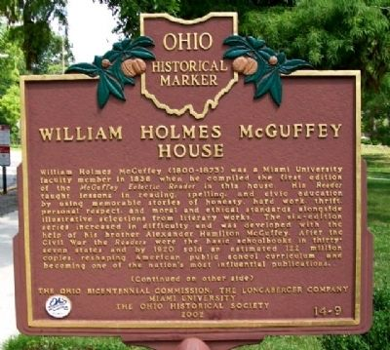
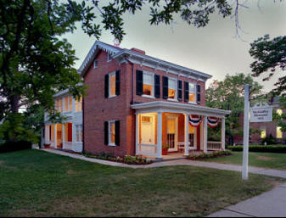
William Holmes McGuffey House

Slide 10
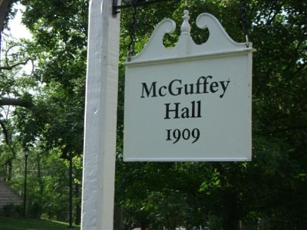
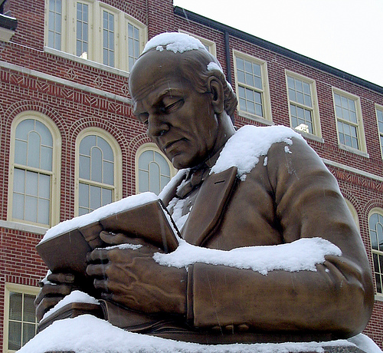
McGuffey Hall

Slide 11
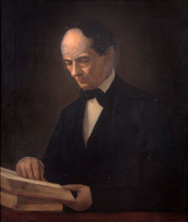
William Holmes McGuffey

Slide 12
What?
What Makes McGuffey famous?
  His McGuffey Readers sold over seven million copies before 1850
  By 1890 the McGuffey Readers had become the basic school readers in thirty-seven states (Clifton, 1933, p. 35).
  McGuffey was responsibly for the compilation of the first four Readers, while the fifth and sixth were compiled by his brother Alexander (Westerhoff, 1982, p. 17)
  The 1879 edition of the Readers sold sixty million copies.

Slide 13
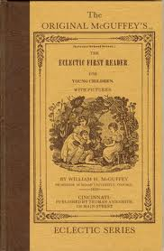
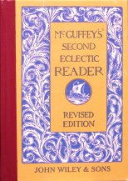
The McGuffey Readers

Slide 14
When?
When did the McGuffey Readers begin to show more familiar childhood activities in their illustrations?
  Children often could not relate to the McGuffey Reader illustrations before 1879.
  Cincinnati artist Henry Farny (1847-1916) and John George Brown (1831-1913) included their paintings of the American West and child-centered urban scenes.
  German-born wood engraver John Karst (1836-1922) was best known for his illustrations in the 1879 and 1880 editions of the McGuffey Readers.

Slide 15
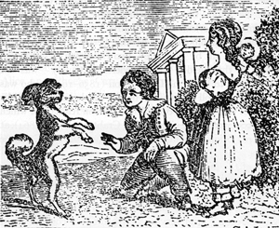
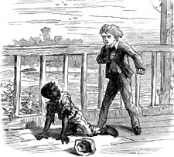
Illustrations from McGuffey Readers

Slide 16
When?
Gorn (1998, p. 33) notes that McGuffey Readers are often accepted with “uncritical sentimentality”.
Should be read with a critical eye toward:
  “nineteenth century schools (which) largely excluded blacks, slighted Catholics, ignored the needs of the working-class and rural people, kept women out of leadership roles, and taught Native Americans that they were inferior” (p. 29).
Consequently, the McGuffey Readers portray American culture as monolithic, even though it was not and has never been (Gorn, 1998, p. 29).

Slide 17
Why?
Why did the McGuffey Readers remain popular for so long?
  Not the only books in schools during the 19th century.
  The typical schoolbooks used in frontier academics were Noah Webster’s An American Selection, Lindley Murray’s English Reader, Albert Picket’s American School Class Books, James Ross’ Latin Grammar, Ruther’s Arithmetic, Jedidiah Morse’s Geography, and Walker’s Readers (Venable, 1891).

Slide 18
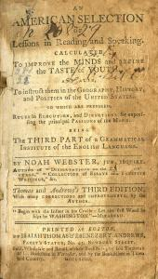
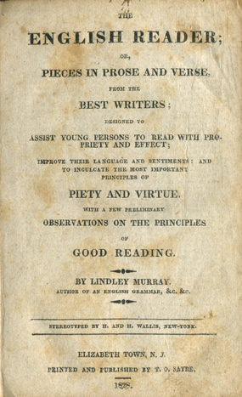
An American Selection by Noah Webster and
The English Reader by Lindley Murray

Slide 19
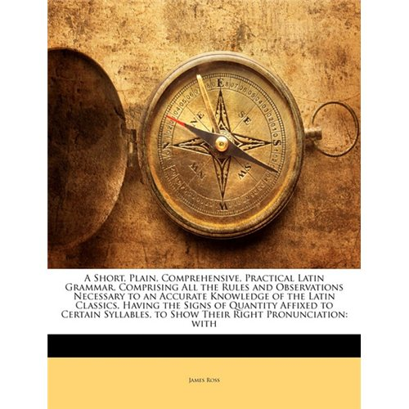
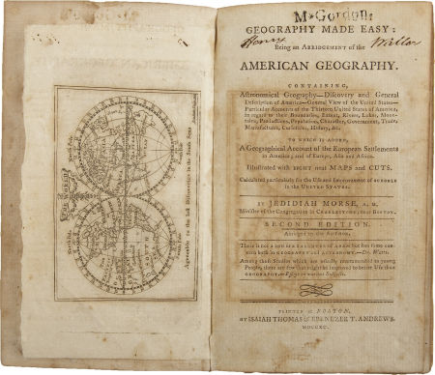
James Ross’ Latin Grammar and Jedidiah Morse’s Geography

Slide 20
Why?
When the McGuffey Readers were organized:
  the basics of grammar, spelling, punctuation, and pronunciation were embedded into a middle-class morality (Gorn, 1998, p. 9).
Were the vehicle to learn about American culture with main themes of:
  childhood, family, virtues, vices, character, education, men and women, religion, the work ethic, citizenship, history and literature (Gorn, 1998).

Slide 21
Why?
35 percent of white children between the ages of 5 and 19 spent time in school in 1830 when the first edition of the McGuffey Readers was released.
In 1859, 50 percent of children spent time in school
In 1870, 61 percent of children spent time in school
By 1890, two out of three children enrolled in school during the years of McGuffey’s greatest popularity (Gorn, 1998).
Throughout the nineteenth century, the spoken word was highly valued.

Slide 22
How?
How did William Holmes McGuffey contribute to education?
  Through his McGuffey Readers, and his early involvement with the Western Library Institute (originally named the College of Teachers).
  “…The Western Library Institute was one of the most important early attempts to organize the teaching profession in the United States…the association affirmed the need to educate the general population about education and to elevate the character of teachers.” (Westerhoff, 1982, p. 50).
  After McGuffey left Miami University, he went on to be a president of two universities.

