Slide 1

Visual Textual Integration to Advance Heath Literacy
Valerie A. Ubbes, PhD, CHES
Miami University
Department of Kinesiology & Health ubbesva@miamioh.edu
35th Annual Association for Interdisciplinary Studies (AIS) Conference
Miami University, Oxford, OH
Marcum Conference Center
November 7, 2013

Slide 2
Abstract
My artistic presentation will showcase a variety of Electronic Texts for Health Literacy (ETHL) for children, youth, and adults. I will describe how the project uses Web 2.0 Technology to produce visual and textual materials to educate for health. The process, principles, and products of ETHL will be discussed as a multi-modal, multi-sensory, and multi-linguistic genre to promote human well being. I will also discuss the interdisciplinarity of our digital literacy partnership.

Slide 3
Presentation Objectives
At the end of this session, participants will be able to:
Define health literacy in the context of interdisciplinarity;
Outline the process of developing websites for health-related literature, including some design principles used for the collection of literacy products;
3. Understand differences between Web 1.0 & Web 2.0 technology.

Slide 4
Objective 1: Define Health Literacy
Health literacy is defined as the ability to speak, read, and write about health.
Healthy People 2020 (USDHHS) defines health literacy as the “capacity to obtain, process, and understand basic health information and services to make appropriate health decisions”.
Health literacy emerges as a transdisciplinary concept in health promotion that will be developed with my talk.

Slide 5
Interdisciplinary Connections
Concepts & skills from one discipline interacting with the concepts & skills of another discipline.

Slide 7
Crossroads of the Health Promotion Profession
By Valerie A. Ubbes, ©2011
Health Education
A profession that promotes human health and disease prevention among individuals and groups.
Key Idea: Health promoters need to use effective methods and materials when educating for health.
Health Communication
A field that studies how humans interpret and make meaning about health through different language patterns and media.
Key Idea: Health promoters use languages and technology as tools when communicating health-related messages among human beings.
Health Science
A sub discipline of science that investigates how the mind and body interacts to sustain people for a healthy life.
Key Ideas: Health promoters explore the integrative study of the social sciences and the biological sciences to solve problems to improve the lives of human beings.
Health Behavior
A field that focuses on healthy or harmful habits that people perceive as either pleasurable or painful.
Key ideas: Health promoters support and encourage people to adapt and respond to changing environments and cultures throughout their lives.

Slide 8
Objective 2: Process, Principles, & Products
I will now outline the process of developing websites for health-related literature, including some design principles used for the collection of literacy products; and
[Explain how I moved from health education into the other crossroads of health communication and health behavior during the design process].

Slide 9
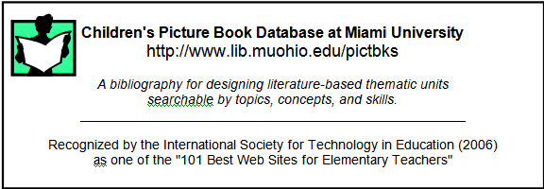
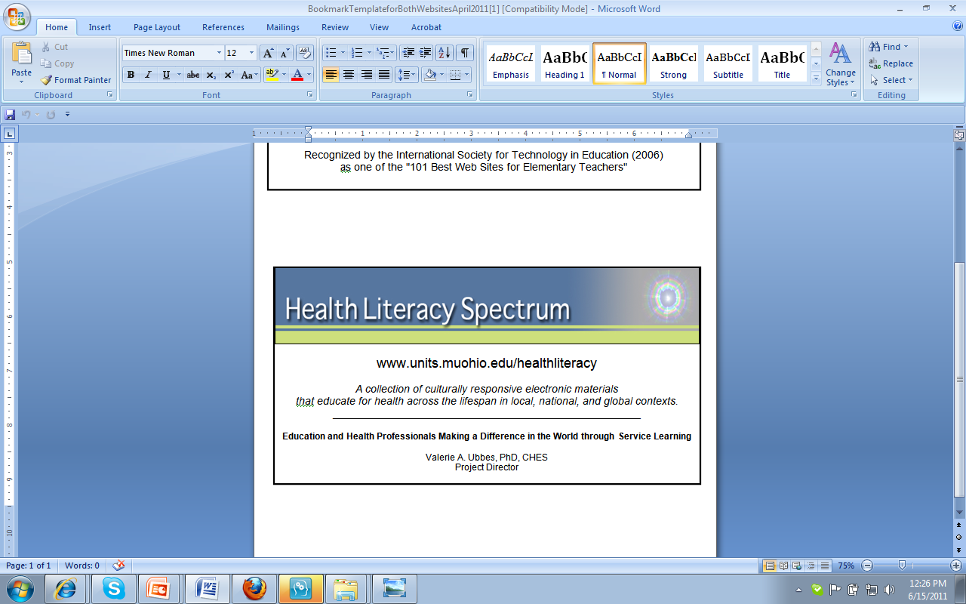
Educational Materials for Health Literacy
Print Materials for Health Literacy
Electronic Texts for Health Literacy
Children’s Picture Book Database at Miami University
www.lib.muohio.edu/pictbks
Health Literacy Spectrum
www.units.muohio.edu/healthliteracy

Slide 10
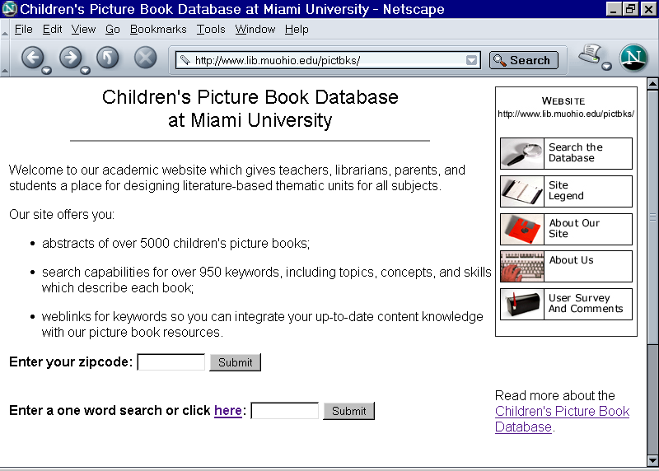
by Valerie A. Ubbes, PhD, CHES
Project Director

Slide 11
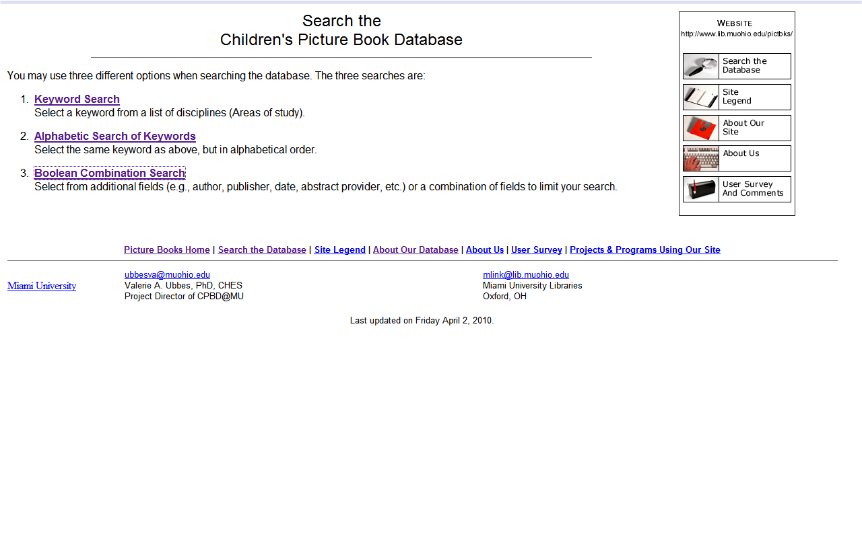
Search for Books 3 Ways:
Notes:
Clear shot needed add a new screen shot for this page

Slide 12
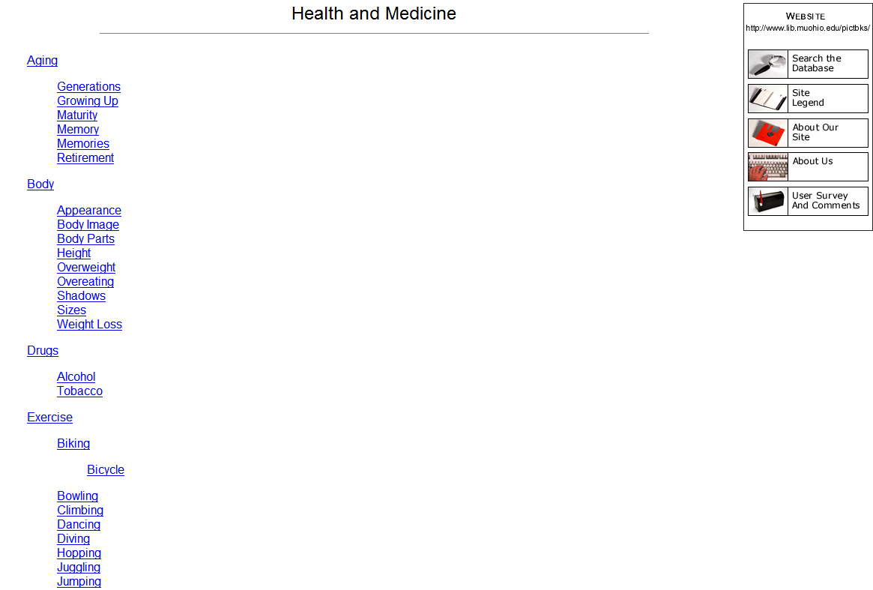

Slide 13
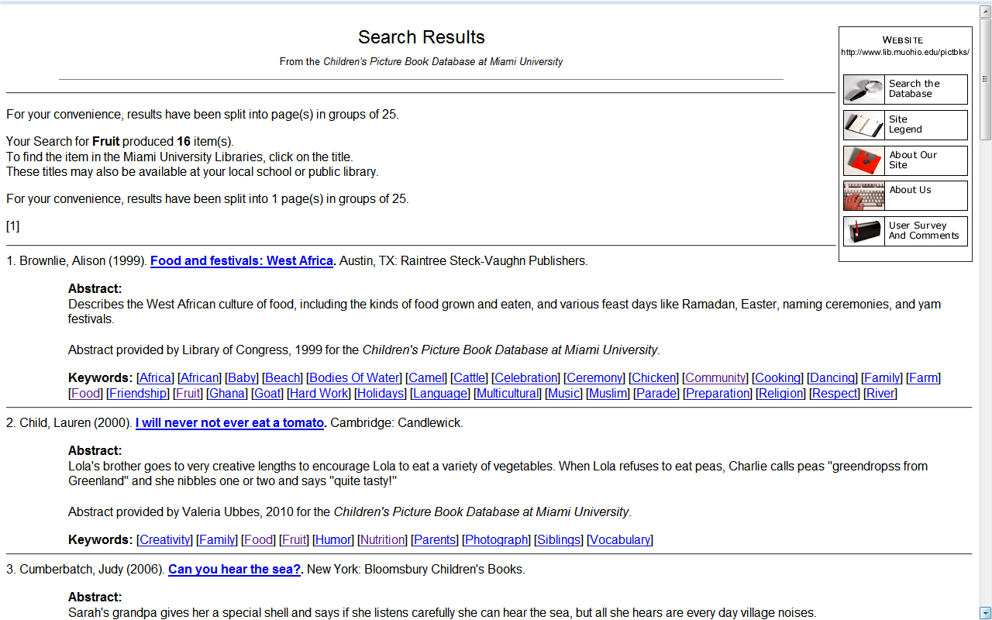

Slide 14
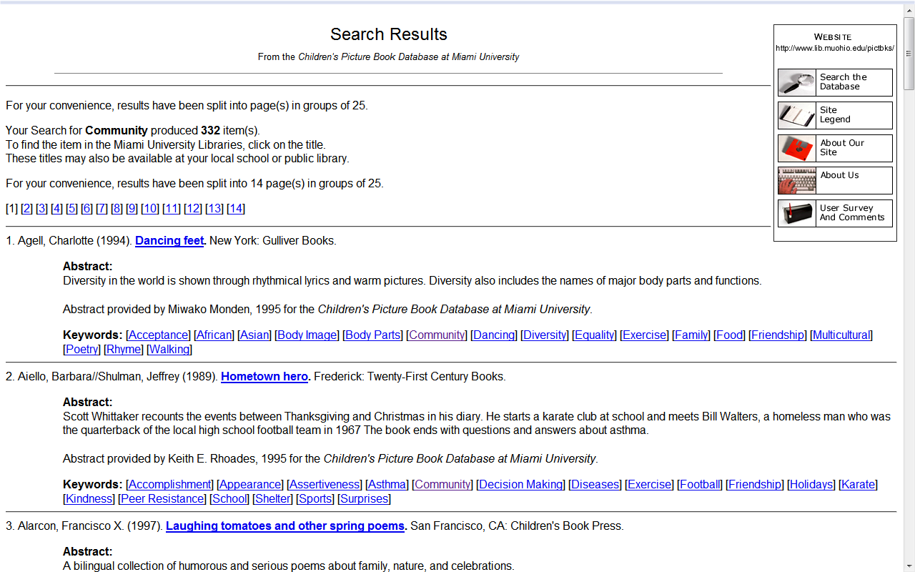

Slide 15

101 Best Web Sites for Elementary Teachers (Lerman, 2005) which uses the National Education Technology Standards

Slide 16
Principle 1: “Educating for Health” via Literature
In an excerpt of the story that follows from
“I Love My Family” (Hudson, 1993), we can use a disciplinary lens of health education to explore the dimensions of Social Health, Physical Health, and Emotional Health.
When different dimensions of health are conceptualized, the concept of wellness is formed….
which can be adopted by the individual in the active form of human well being – aka health behaviors.
After seeing a few pages of the story, we will look at the database entry for the book in order to identify the topics, concepts, and skills.

Slide 17
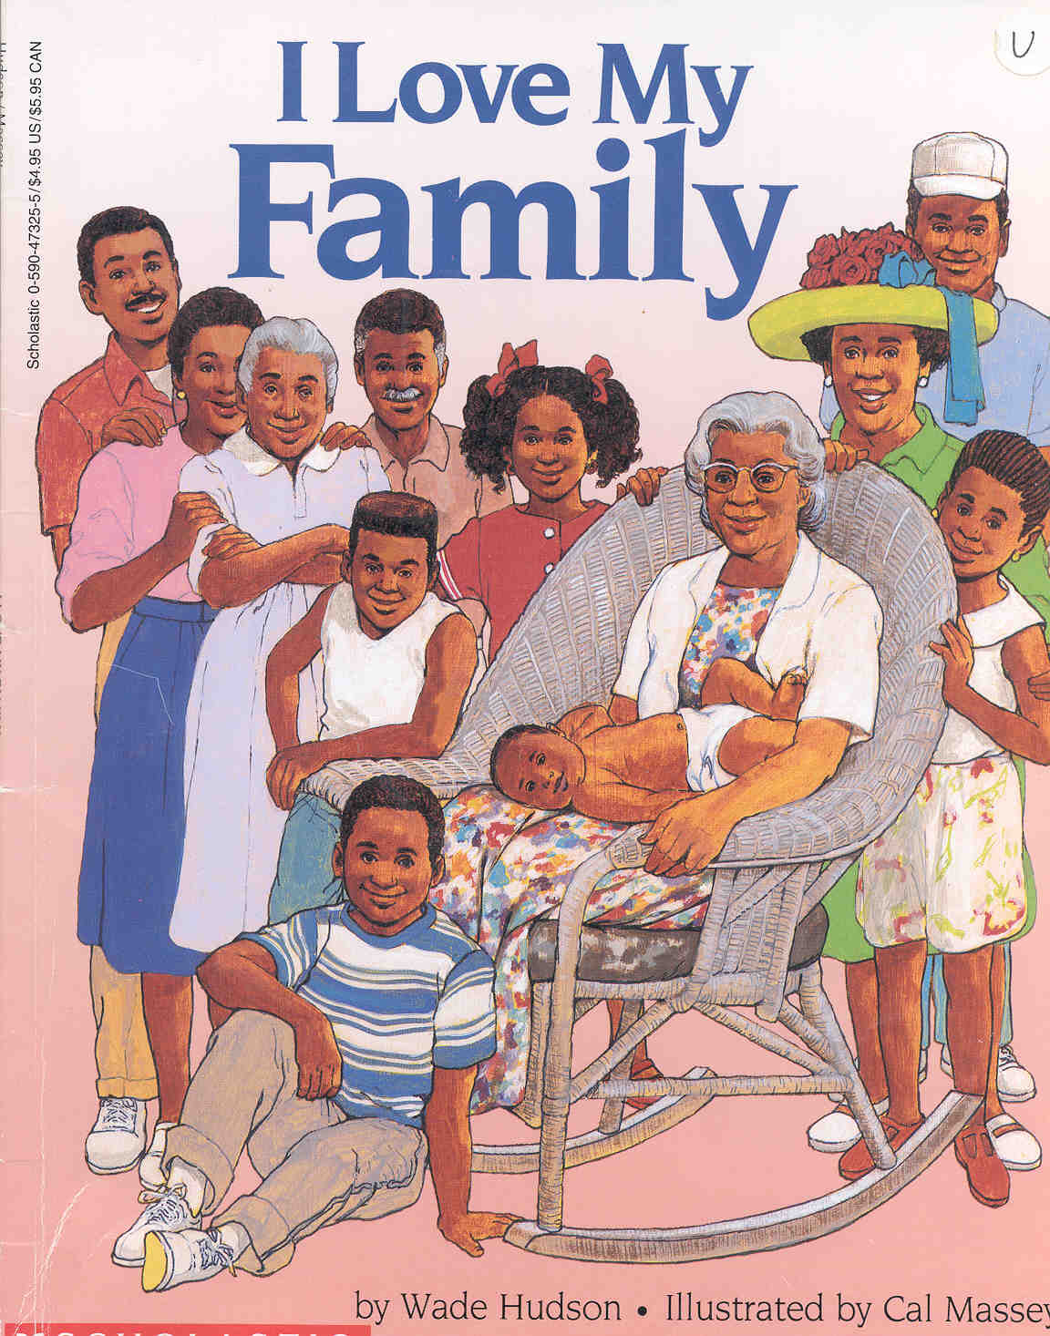

Slide 18
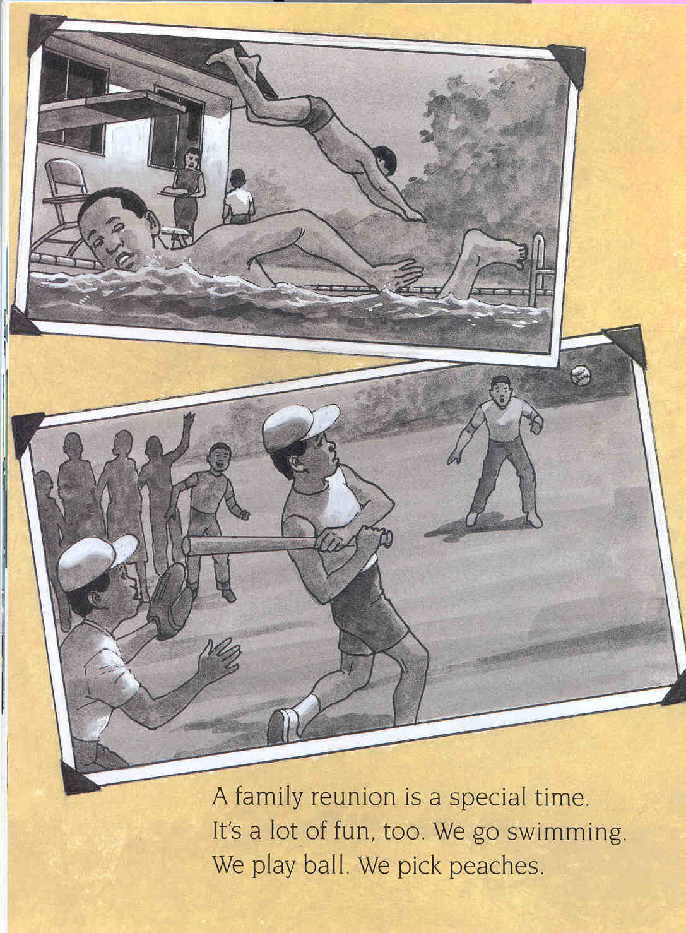

Slide 19
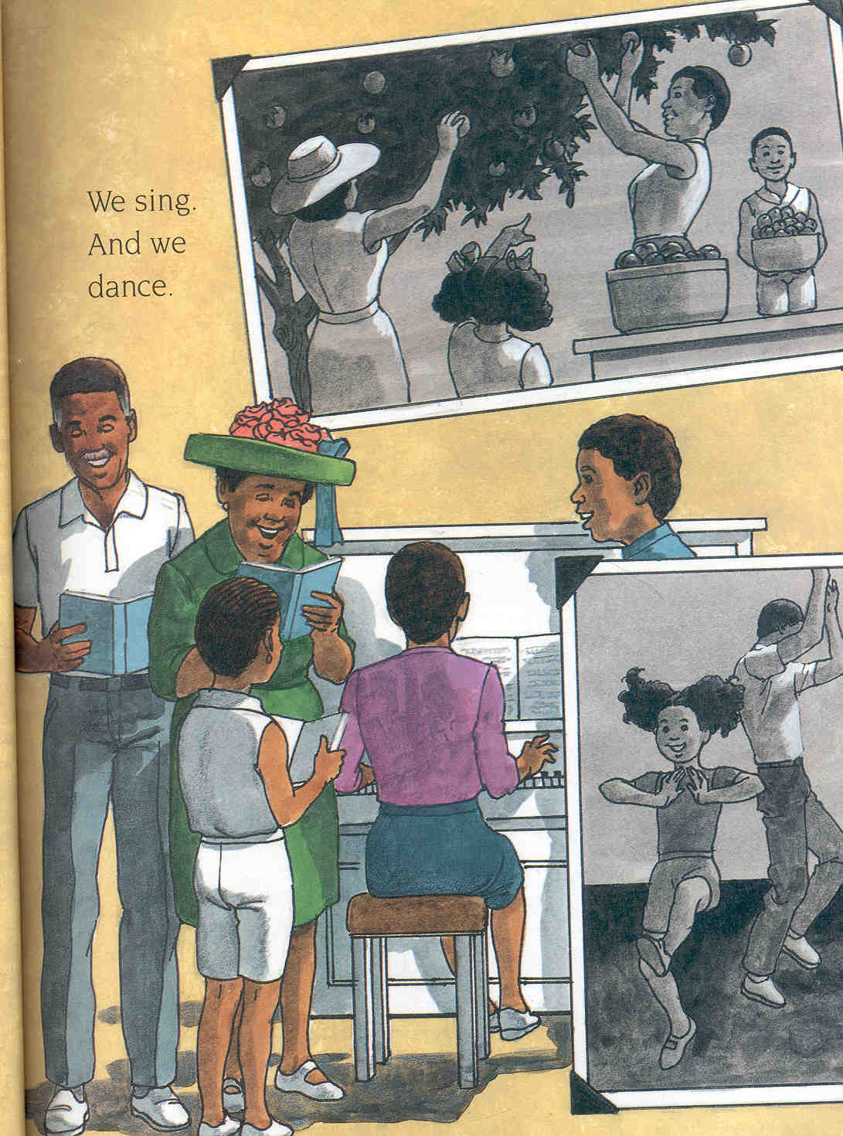

Slide 20
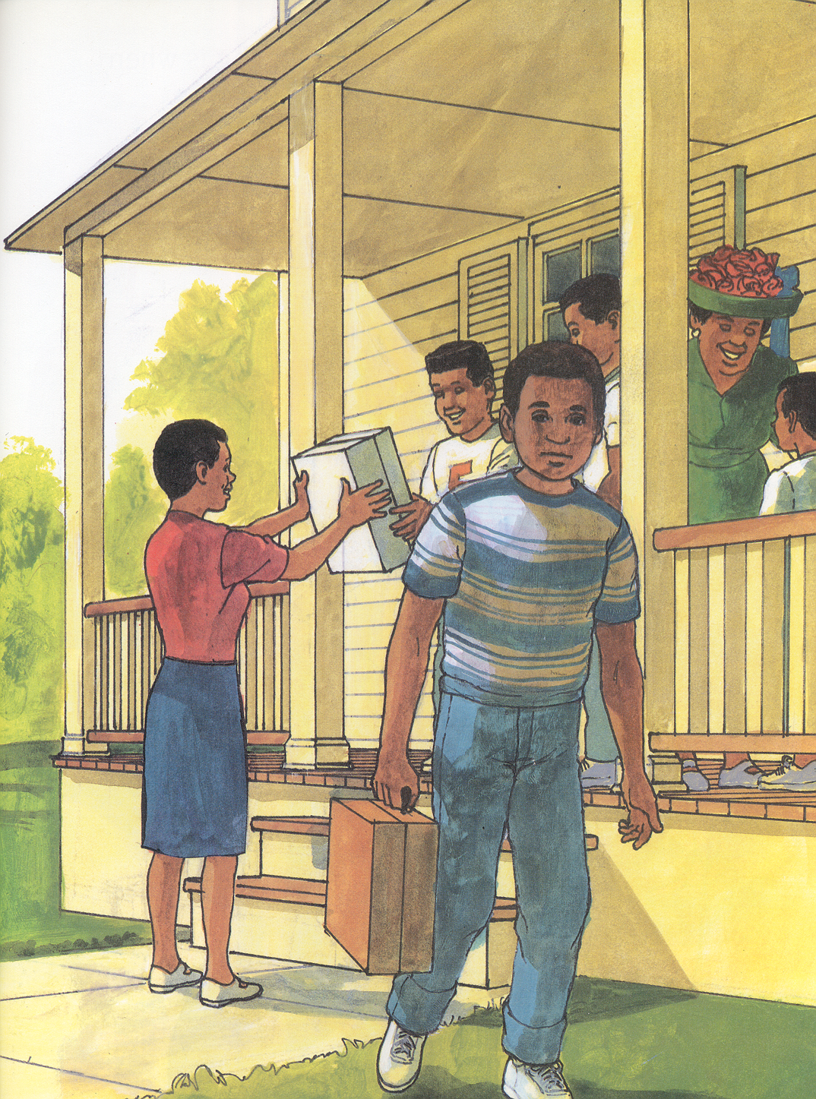
When the family reunion is over, everyone is sad. No one wants to say good-bye. I feel sad, too. I won't get to see most of my cousins again until next summer.

Slide 21
Sample Abstract from CPBD@MU
55. Hudson, Wade. (1993). I love my family. New York: Scholastic Inc.
  Abstract:
  A family takes a summer trip to Grandpa Lawrence's farm in North Carolina. The family enjoys laughing, talking, playing basketball, dancing, and having a picnic together. Everyone hates to leave at the end of the week.
  Abstract provided by Sarah Inglis, 1995 for the Children's Picture Book Database at Miami University.
  Keywords: [African American] [Family] [Food] [Music] [Multicultural] [Nutrition] [Picnic] [Health] [Celebration]
  [Storytelling] [Reunion] [Dancing] [Basketball] [Sports] [Feelings] [Communication]

Slide 22
2. Function: Types of Searches
Each picture book gets 10 to 15 words assigned to it from assessing the story line as topics, concepts, & skills;
Can also “uncover” the text, subtext, & context of books
Text – the storyline in textual (word) form
Context - the place and setting of the story
Subtext – the topics, concepts, and skills via other forms:
  pictures & illustrations, and sometimes photographs,
  body language,
  environmental cues,
  numbers, and
  rhythm.

Slide 23
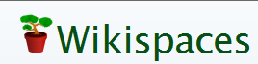
Principle 2:
Web 1.0 versus Web 2.0 Technology
Web 1.0 Technology
Web 2.0 Technology
Consumers are receivers of health information.
Passive learners.
Compliance culture.
Kukafka, R. (2008). Internet approaches for eHealth in low literacy and limited English proficiency populations. Powerpoint presentation at the Institute of Medicine workshop on health literacy, eHealth, and communication: Putting the consumer first. Washington, DC, March 17. Also found in Hernandez, L.M. (2009). Health literacy, eHealth, and Communication: Putting the consumer first. Washington, DC: The National Academies Press, p. 34.
Consumers are co-producers of health information.
Active learners.
Enabling culture.
One example:
Wikis act as editable web pages

Slide 24
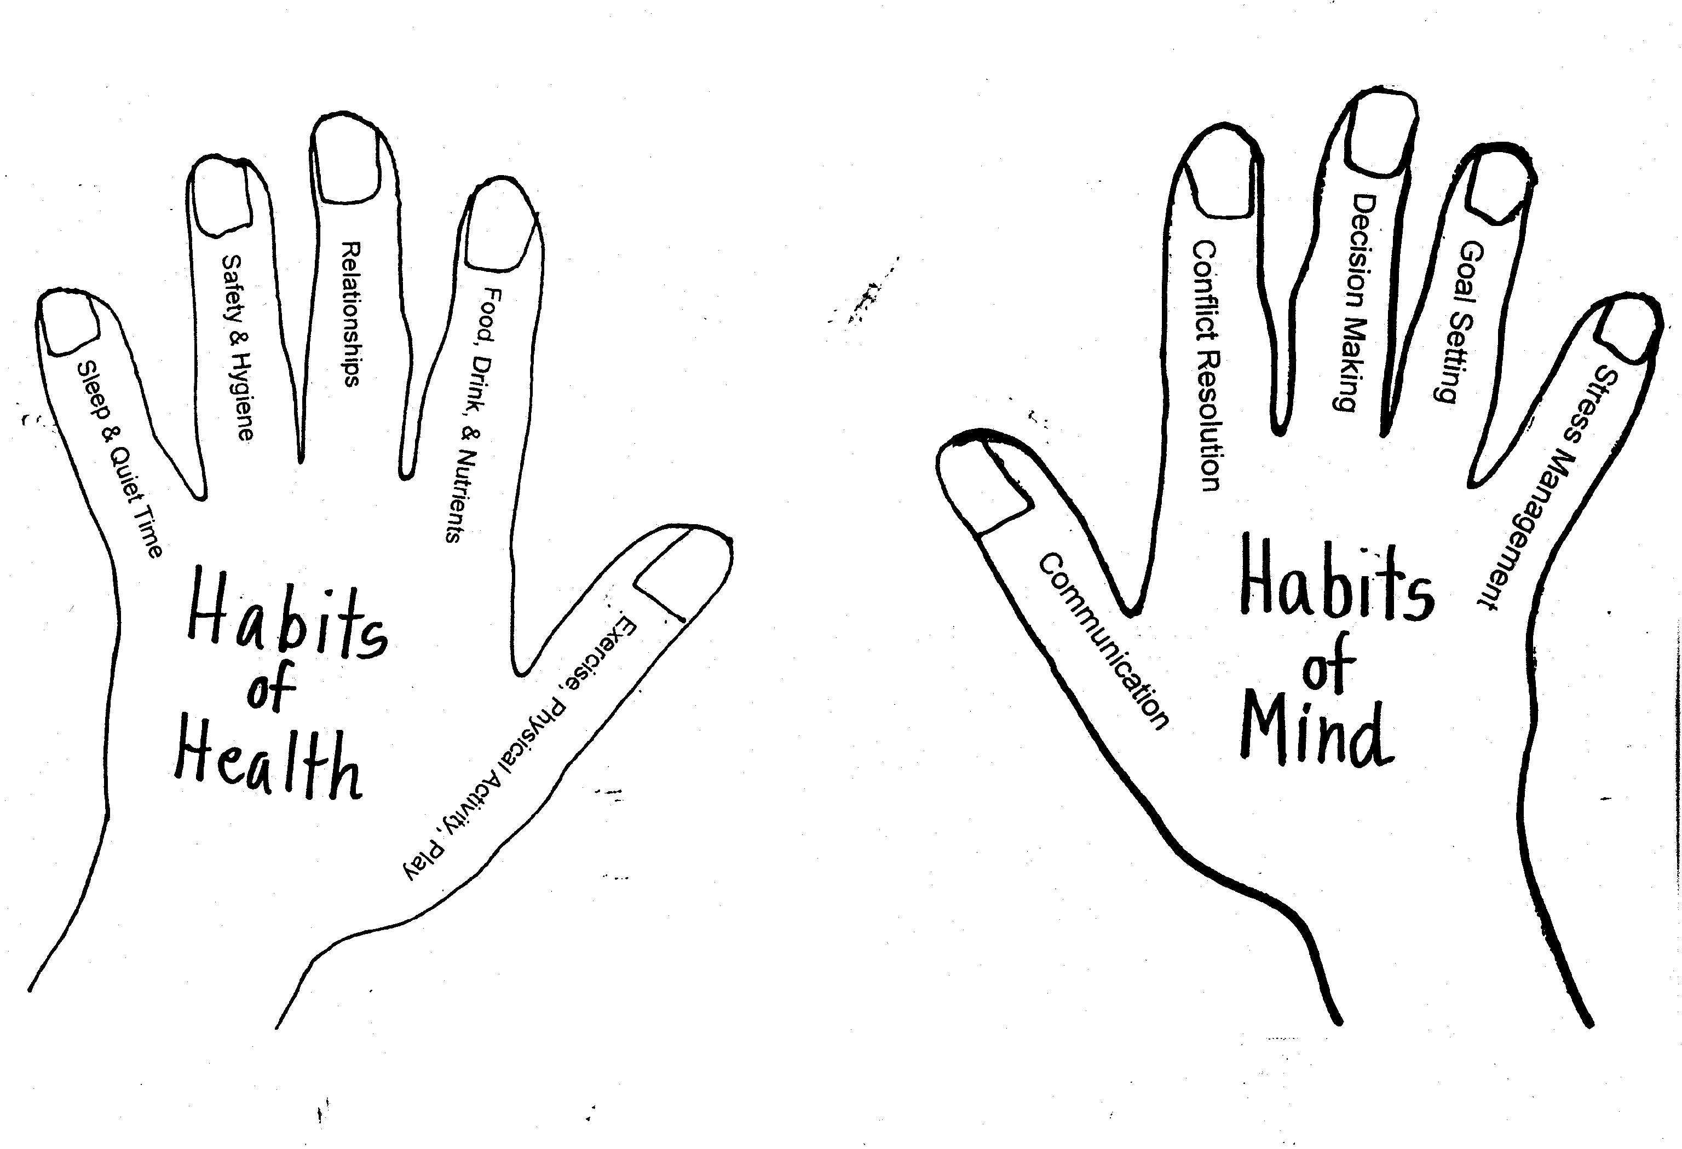
Habits of Health and Habits of Mind model
All rights reserved, © V.A. Ubbes in Educating for Health (Human Kinetics, 2008), p. 113.

Slide 25

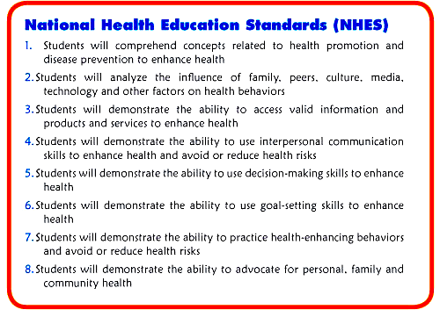
HEALTH EDUCATION
For preK-grade 12

Slide 26
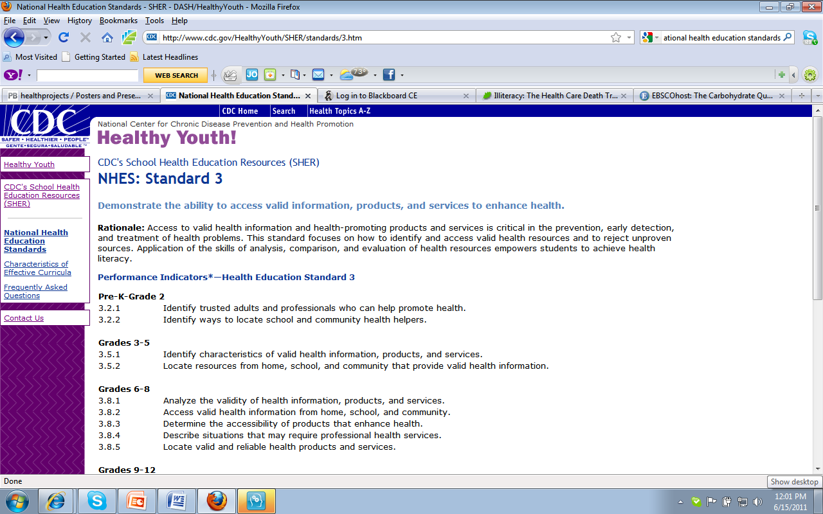
National Health Education Standards (2007)
Put list of NHES here with # 3 highlighted

Slide 27
Health Education Standards & Health Literacy
Health literacy in emphasized in standard #3 of 8;
National Health Education Standards include performance indicators by grade levels that assesses what students know and are able to do;
Need to ask kids to show how they know health education (and not just show that they know);
The standards can be simplified by one model called the Habits of Health and Habits of Mind (Ubbes, 2008).

Slide 28
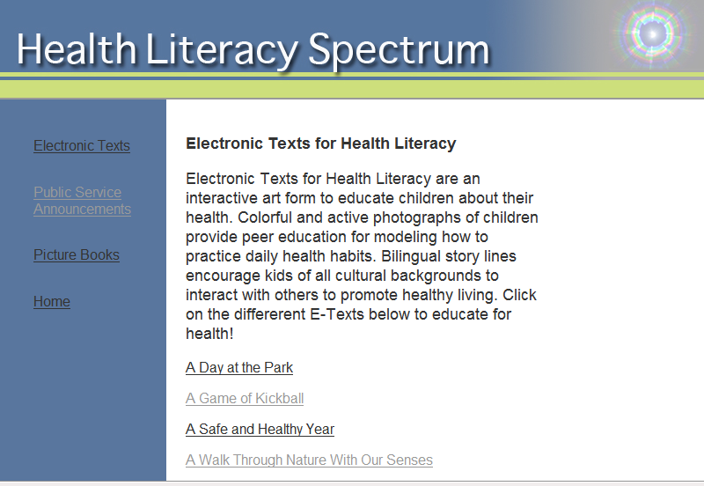
2. Electronic Texts for Health Literacy http://www.units.muohio.edu/healthliteracy/Etext2009_2010.html

Slide 29
Electronic Texts for Health Literacy©
Are a new genre of literature that includes a personal health narrative (story) with valid and reliable health information (expository text).
By combining story and theory (i.e., curriculum standards) to inform the design process, more authentic forms of health literacy are developed:
  Words that develop vocabulary for the naming of body parts, body actions, and body mind connections;
  Realistic photographs showing lifestyle habits and health behaviors; and
  Situational and environmental cues that show sequential processes and rhythmic patterns from daily life.

Slide 30
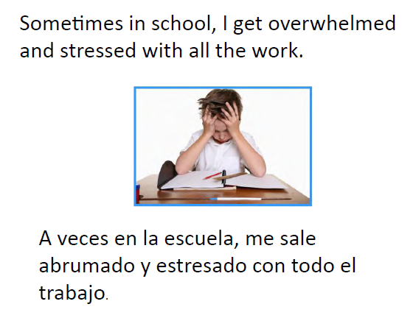
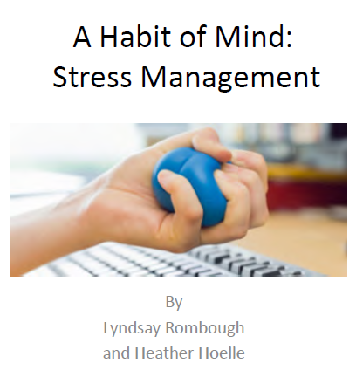
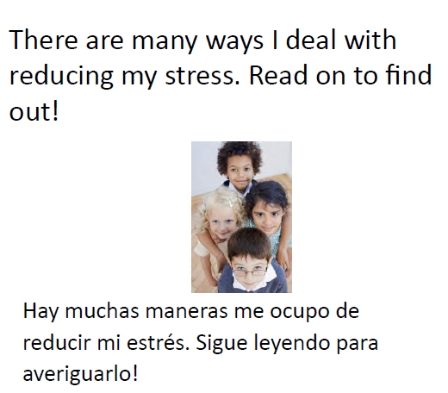

Slide 31
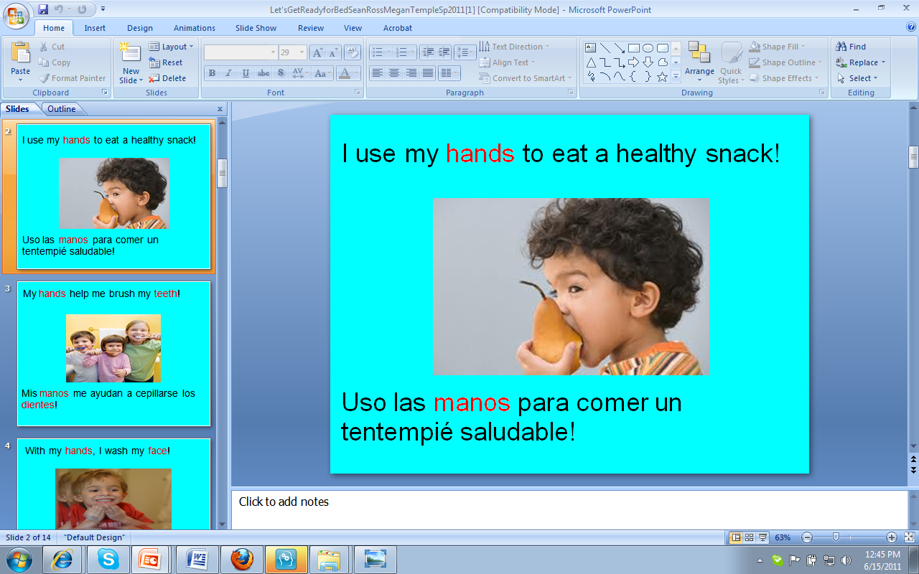
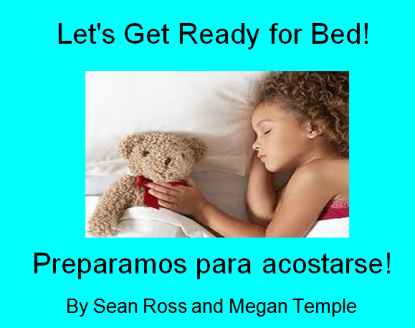
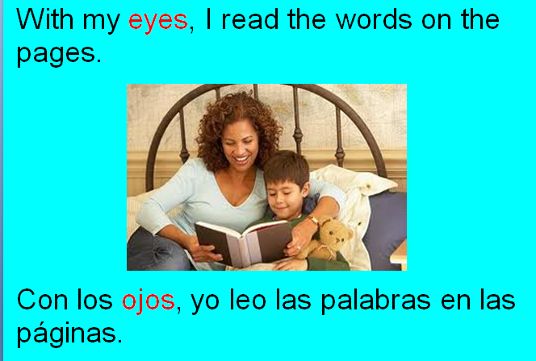
Example #2: E-Text for Health Literacy
Example 1
Themes:

Slide 32
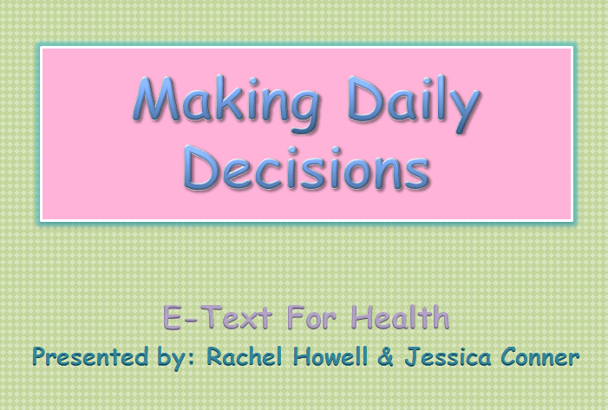
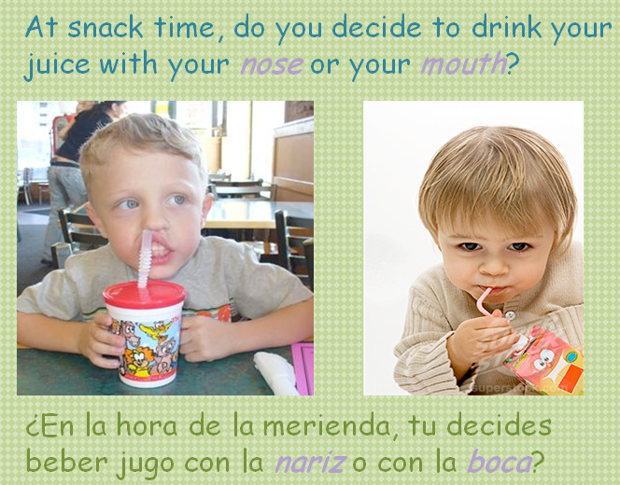
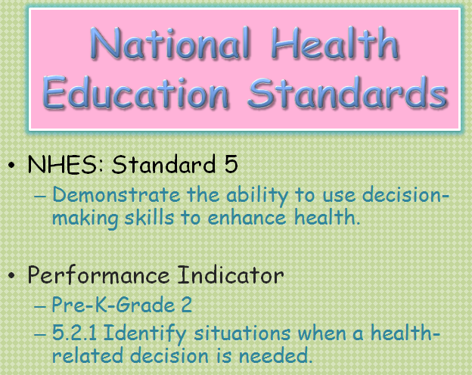
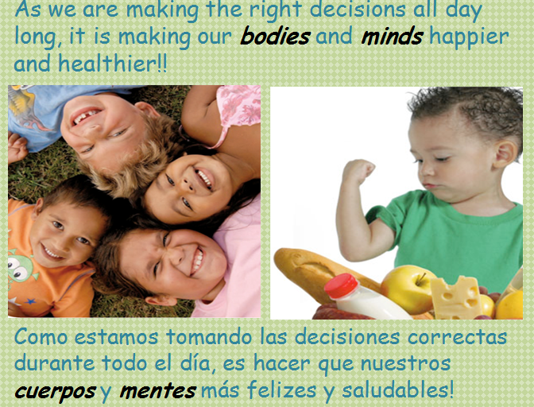
Example #3: E-Text for Health Literacy
Example 2
Themes

Slide 33
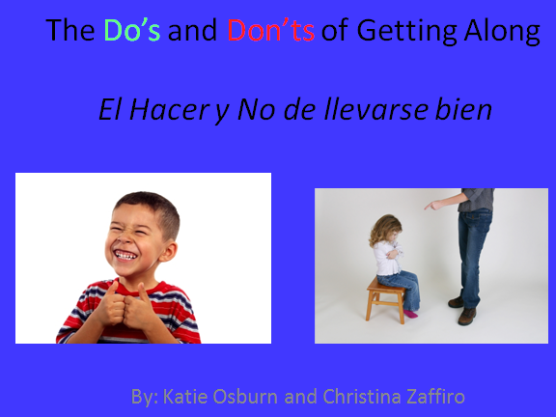
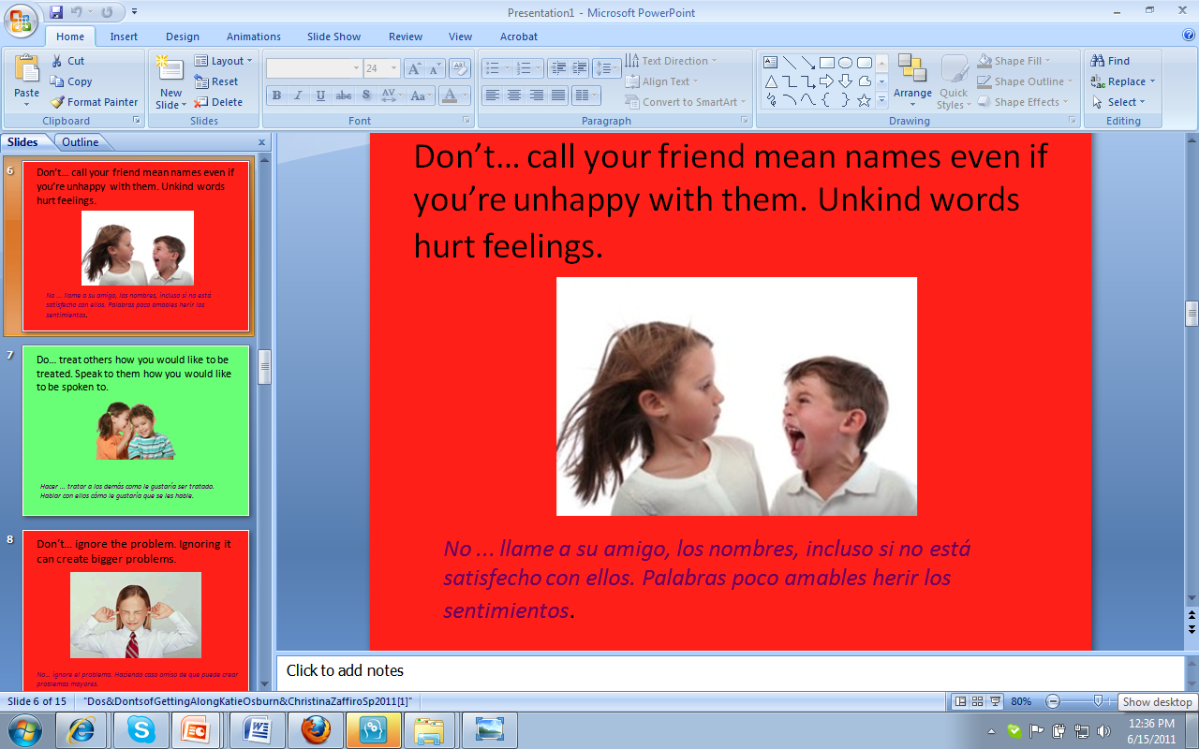
Example #4: E-Text for Health Literacy
Example 3
Themes

Slide 34
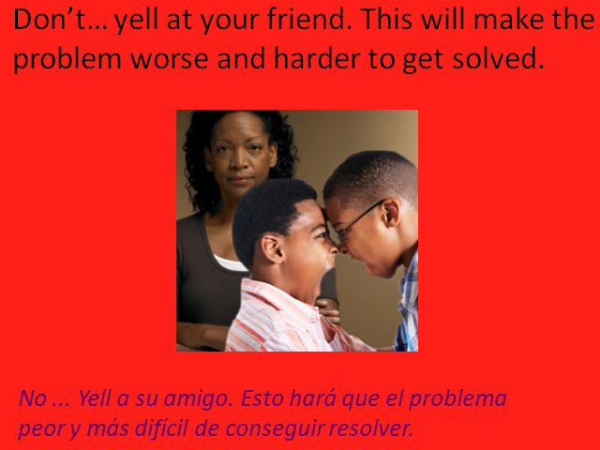
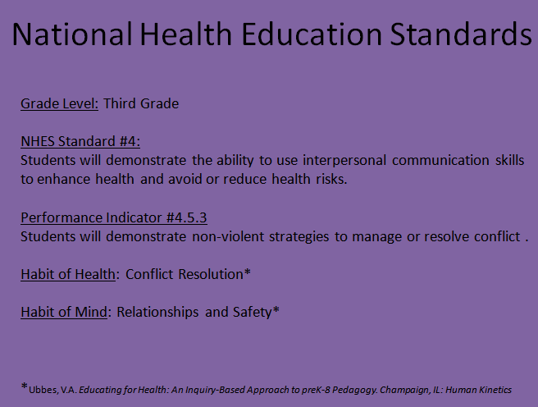
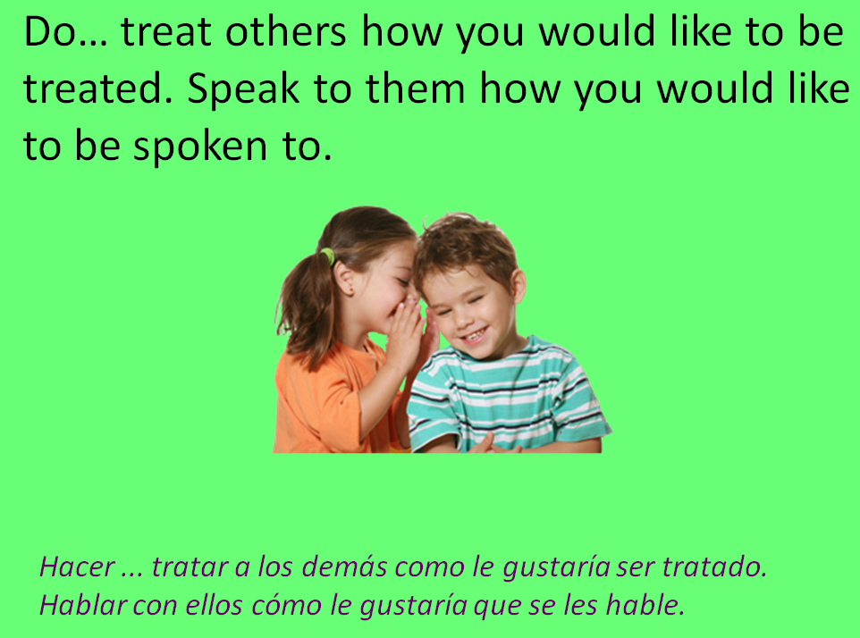
Using interpersonal communication skills
Example 3
Themes

Slide 35
Current Project
Merge both databases into a combined new site through the Center for Digital Scholarship at Miami University;
Increase access to health-related materials that are both print and electronic collections;
Promote Digital Literacy Partnerships (DLP) beyond my own projects to include other faculty projects to increase interdisciplinarity at Miami University.

Slide 36


Slide 37
http://wiggins.lib.muohio.edu/ http://wiggins.lib.muohio.edu/healthliteracy/

Slide 38
References
Kukafka, R. (2008). Internet approaches for eHealth in low literacy and limited English proficiency populations. Powerpoint presentation at the Institute of Medicine workshop on health literacy, eHealth, and communication: Putting the consumer first. Washington, DC, March 17. Also found in Hernandez, L.M. (2009). Health literacy, eHealth, and Communication: Putting the consumer first. Washington, DC: The National Academies Press, p. 34.
Ubbes, V.A. (2008). Educating for health. Champaign, IL: Human Kinetics.

